Slide 1

AVOID CREATING UNNECESSARY OBJECTS

Slide 2
Why to do it?
Save memory
To improve speed program
Easy inspection and maintenance

Slide 3
How to avoid creating unnecessary objects?
Only their values ​​initialized when need to use.
For example:
public class Countries {
private List countries;
public List getCountries() {
//initialize only when required
if(null == countries) {
countries = new ArrayList();
}
return countries;
}
}

Slide 4
How to avoid creating unnecessary objects?
Reuse a single object instead of creating a new functionally equivalent object each time it is needed. An object can always be reused if it is immutable.
You can often avoid creating unnecessary objects by using static factory methods.
In addition to reusing immutable objects, you can also reuse mutable objects if you know they won’t be modified

Slide 5
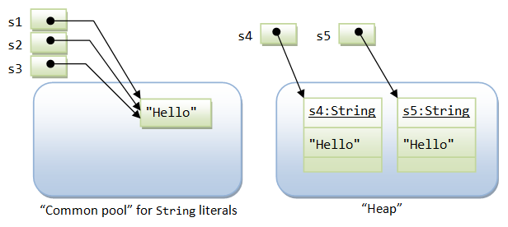
How to avoid creating unnecessary objects?
For example:
+ Ex1: String s4 = new String(“Hello”); // don’t do this
=> String s1 = “Hello”;

Slide 6
How to avoid creating unnecessary objects?
+ Ex2:
class Person1{ private Date birthDate = new Date(2000,1,1); public boolean isBabyBoomer(){ Calendar gmtCal = Calendar.getInstance(TimeZone.getTimeZone("GMT")); gmtCal.set(3900, Calendar.JANUARY, 1, 0, 0, 0); Date boomStart = gmtCal.getTime(); gmtCal.set(3920, Calendar.JANUARY, 1, 0, 0, 0); Date boomEnd = gmtCal.getTime(); return (birthDate.compareTo(boomStart) >= 0) && (birthDate.compareTo(boomEnd) < 0); } }

Slide 7
How to avoid creating unnecessary objects?
+ ex3:
class Person2{ private Date birthDate = new Date(2000,1,1); static final Date BOOMSTART; static final Date BOOMEND; static { Calendar gmtCal = Calendar.getInstance(TimeZone.getTimeZone("GMT")); gmtCal.set(3900, Calendar.JANUARY, 1, 0, 0, 0); BOOMSTART = gmtCal.getTime(); gmtCal.set(3920, Calendar.JANUARY, 1, 0, 0, 0); BOOMEND = gmtCal.getTime(); } public boolean isBabyBoomer(){ return (birthDate.compareTo(BOOMSTART) >= 0) && (birthDate.compareTo(BOOMEND) < 0); } }

Slide 8
How to avoid creating unnecessary objects?
Priority use primitive data types for the variables
public static void main(String[] args) {
Long sum = 0L;
for (long i = 0; i < Integer.MAX_VALUE; i++) {
sum += i;
}
System.out.println(sum);
}

